Slide 1
HDInsight & Power BI
By Łukasz Gołębiewski

Slide 2
Agenda
Theory
What is Hadoop in Big Data world
Hadoop versions
HDInsight as a cloud implementation of Hortonworks Hadoop
Hdinsight storage
Hadoop file formats
Available connectors
Practice
Connecting to HDInsight with Excel Power Query
Connecting to HDInsight with Desktop BI

Slide 3
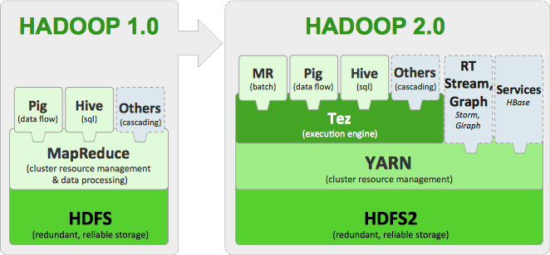
HADOOP 1.0 VS HADOOP 2.O
Source: https://hortonworks.com/blog/apache-hadoop-2-is-ga/

Slide 4
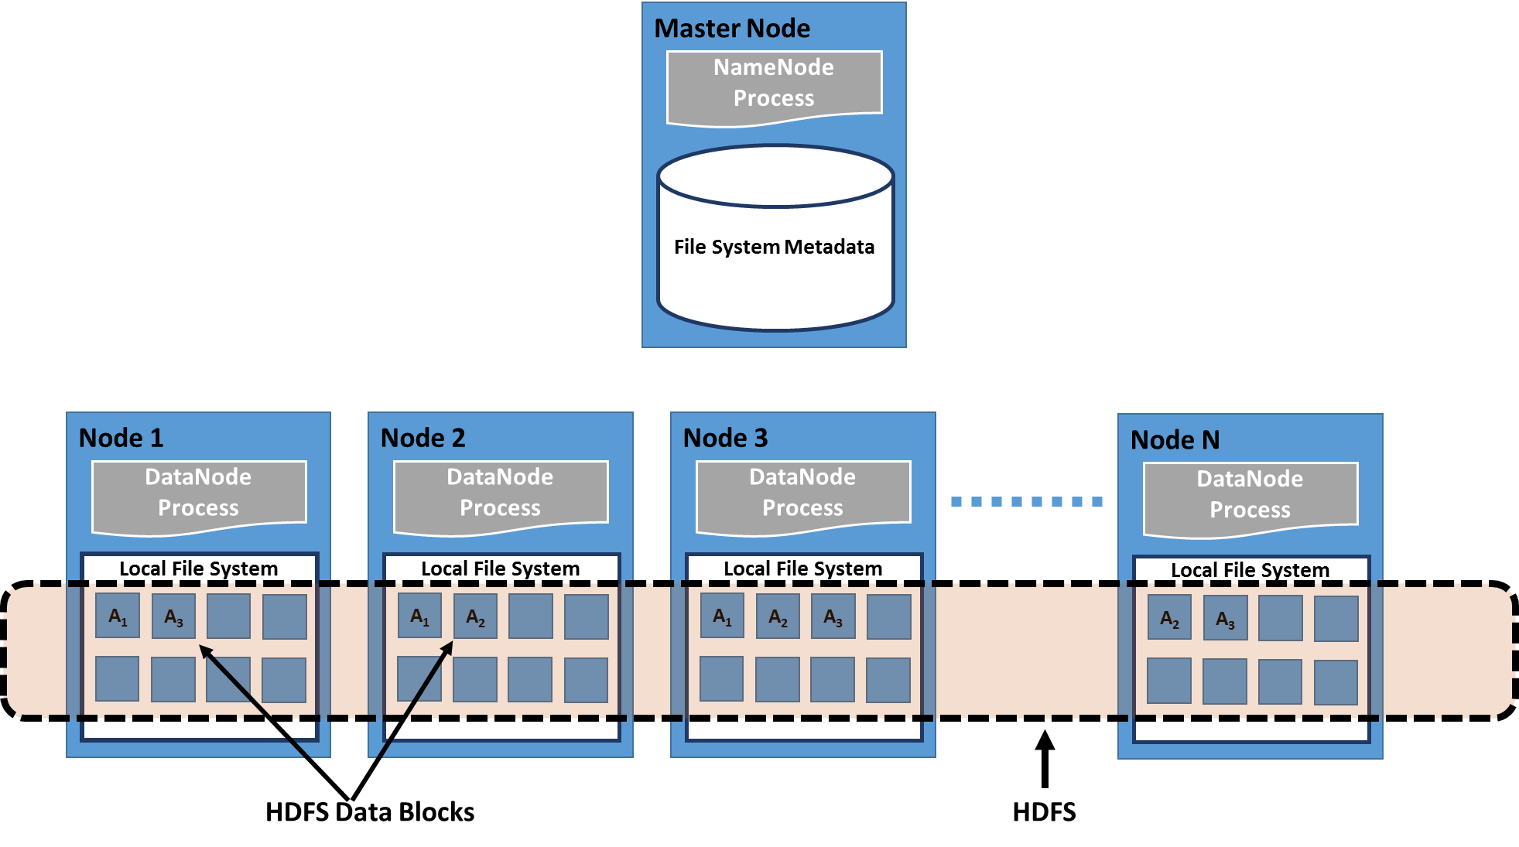
HADOOP 1.0 & HADOOP 2.O Storage
https://hub.packtpub.com/hadoop-and-mapreduce/
Notes:
Connector in Excel for HDFS

Slide 5
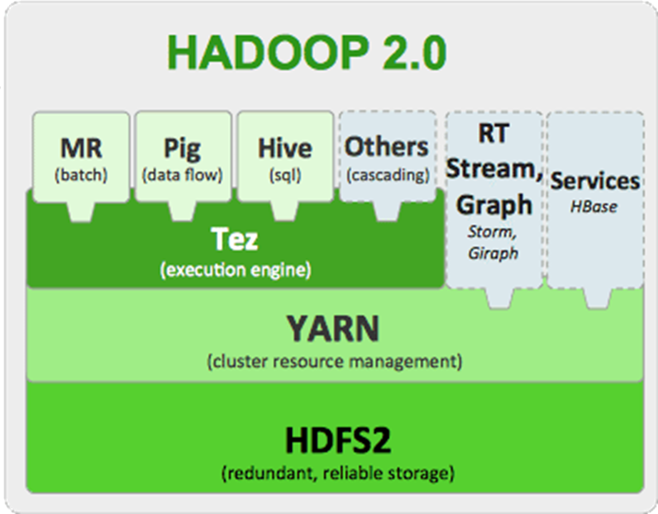

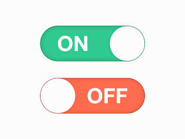
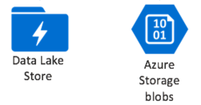
Azure HDInsight (PAAS)

Slide 6
HDInsight cluster types
Source: https://docs.microsoft.com/en-us/azure/hdinsight/hadoop/apache-hadoop-introduction

Slide 7
Comparing ADLS and ABS
Source: https://docs.microsoft.com/en-us/azure/data-lake-store/data-lake-store-comparison-with-blob-storage

Slide 8
Azure Account Storage
BLOB Storage
General Storage
BLOB Storage
Tables
Queues
SMB 3.0

Slide 9
Hadoop File Formats: It's not just CSV anymore
Text/CSV Files
JSON Records
Avro Files
Sequence Files
RC Files
ORC Files
Parquet Files
Source: https://community.hds.com/community/products-and-solutions/pentaho/blog/2017/11/07/hadoop-file-formats-its-not-just-csv-anymore

Slide 10
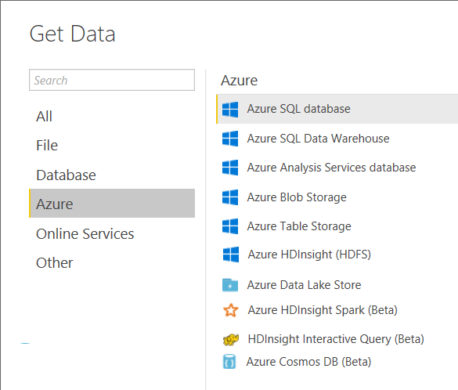
What can you do with Excel and what with PowerBI?

Slide 11
DEMO ☺
Excel
Azure Table Storage
Azure Blob Storage
Azure HDInsight (HDFS)
Desktop BI
Azure HDInsight (Spark)
HDInsight Interactive Query
Azure Data Lake Store

Slide 12
Summary
There are substantial differences between onprem & cloud implementation of Hadoop
Excel and Power BI Desktop differ in terms of supported connectors
Account storage is not only a storage – it is also provide computation layer
Power Query is not able to digest Hadoop file formats directly
Azure Blob Storage vs Azure HDInsight (HDFS) – what is a real difference?
Azure HDInsight (Spark) get data from Hive tables
HDInsight Interactive Query get data from Hive tables like Spark
Azure Data Lake Store – work looks pretty much the same as with AAS - BLOBs

Slide 13
Thank you! ☺

